Slide 1
BCSE306
Artificial Intelligence
Dr.Priyanka N
Assistant Professor
School of Computer Science and Engineering (SCOPE),
VIT Vellore,
priyanka.n@vit.ac.in

Slide 2
Objectives
To impart artificial intelligence principles, techniques and its history.
To assess the applicability, strengths, and weaknesses of the basic knowledge representation, problem solving, and learning methods in solving engineering problems
To develop intelligent systems by assembling solutions to concrete computational problems

Slide 3
Course Outcome
Evaluate Artificial Intelligence (AI) methods and describe their foundations.
Apply basic principles of AI in solutions that require problem solving, inference, perception, knowledge representation and learning.
Demonstrate knowledge of reasoning and knowledge representation for solving real world problems.
Analyze and illustrate how search algorithms and planning play vital role in problem solving.

Slide 4
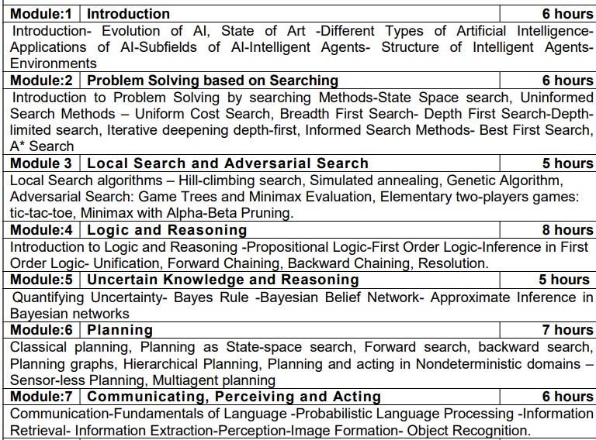

Slide 5
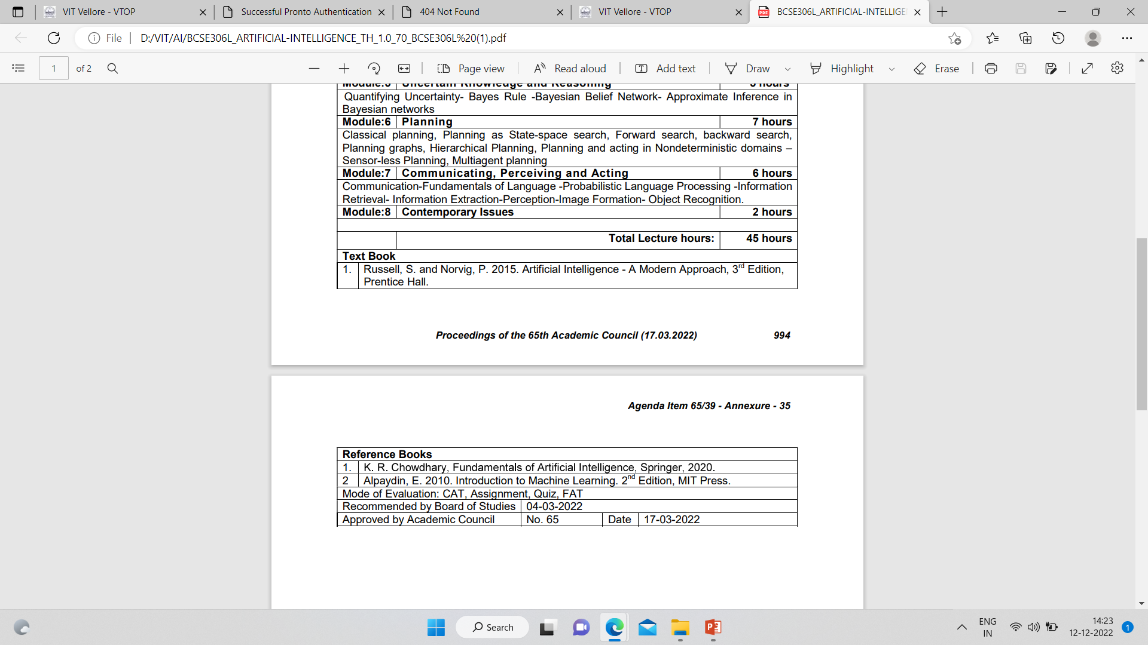


Slide 6
ONLINE COURSE
https://nptel.ac.in/courses/106106226
https://onlinecourses.nptel.ac.in/noc23_cs09/preview

Slide 7
Definition
AI is a branch of computer science, aims on building machines and software with intelligence similar to humans so that they can perform similar thinking, reasoning, decision-making, problem solving and natural language processing like human.

Slide 8
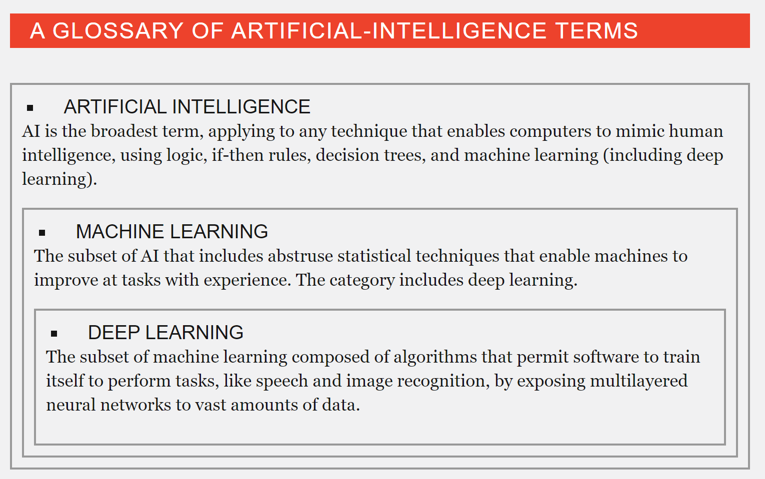

Slide 9
What is AI?
Artificial intelligence (AI) is the technology and a branch of computer science that studies and develops intelligent machines and software.
“The study and design of intelligent agents”
An intelligent agent is a system that perceives its environment and takes actions that maximize its chances of success.
John McCarthy coined the term AI in 1956
Defines it as "the science and engineering of making intelligent machines".

Slide 10
Various Definitions of AI
AI is the automation of activities that we associate with human thinking, activities such as decision-making, problem-solving, learning… …
-Bellman, 1978
AI is concerned with designing intelligent computer systems that exhibit the characteristics we associate with intelligence in human behavior
-Barr and Feignenbaum, 1981
AI is the exciting new effort to make computers think machines with minds, in the full and literal sense
- Haugeland, 1985

Slide 11

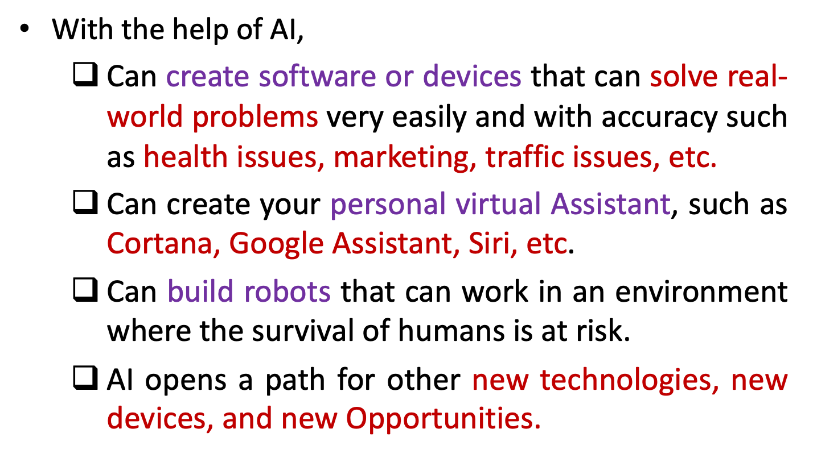

Slide 12

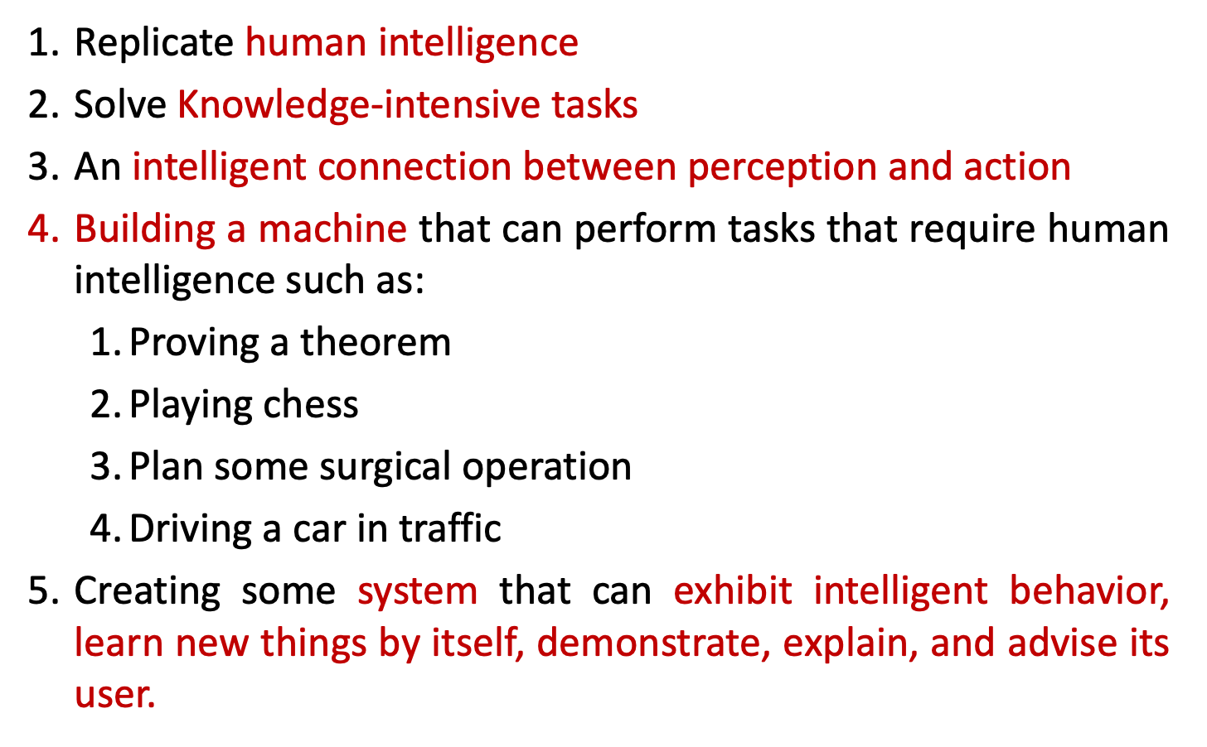

Slide 13

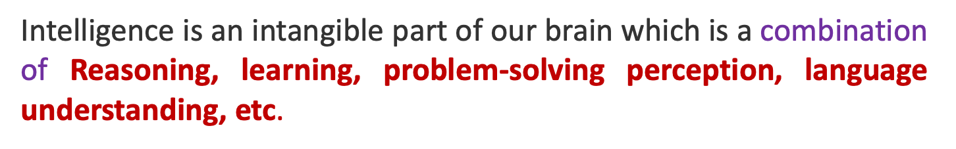
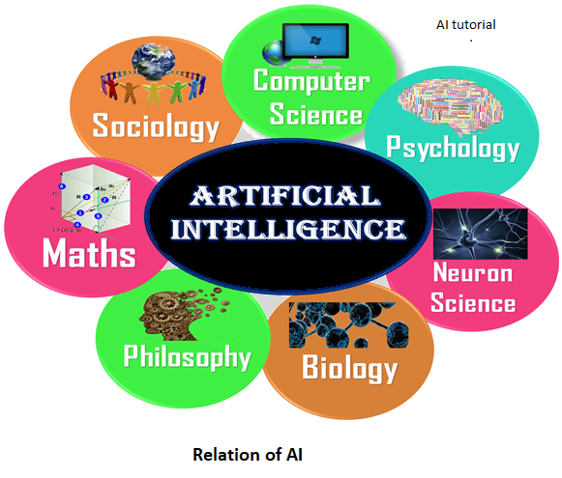

Slide 14
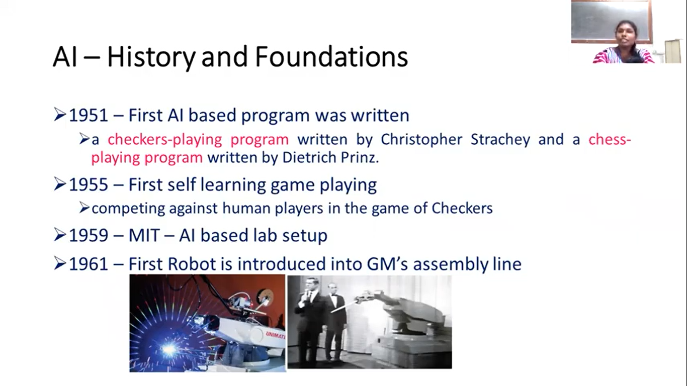
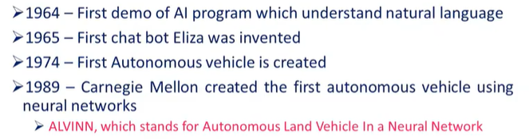

Slide 15
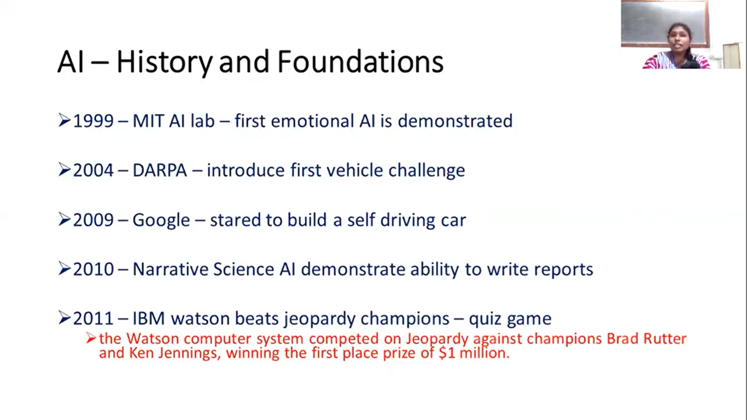
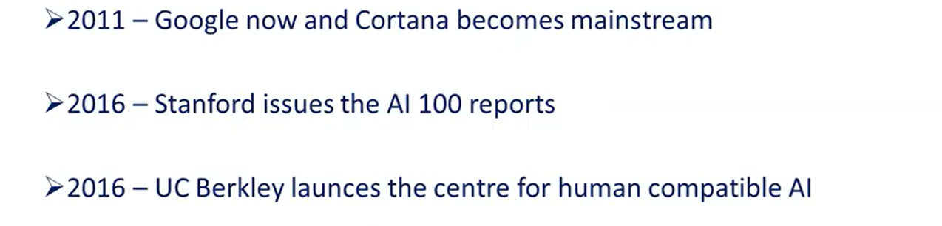

Slide 16
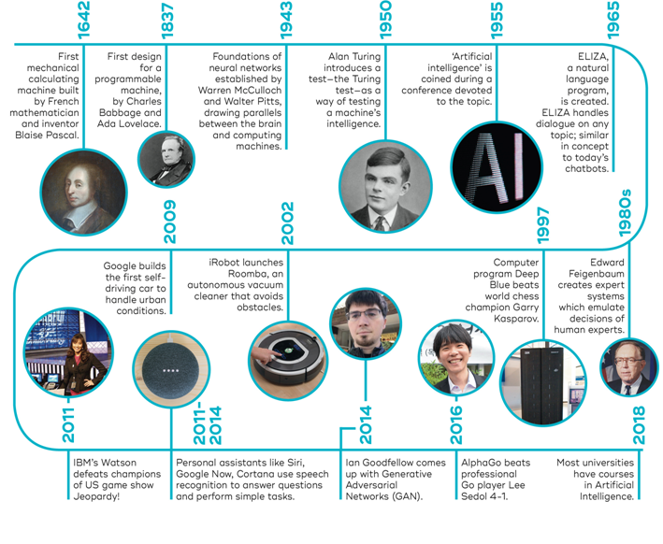
History of AI

